Slide 1
Training Session

Slide 2
+
Wait…

Slide 3
Move and hit the target!

Slide 4
+

Slide 5
Wait until the boxes disappear

Slide 6
+
Come back to the center and wait

Slide 8
Study Session

Slide 9
+
Wait…

Slide 10
Move and hit the target!

Slide 11
+

Slide 12

Remember the object and location

Slide 13
+
Wait…

Slide 14
Move and hit the target!

Slide 15
+

Slide 16
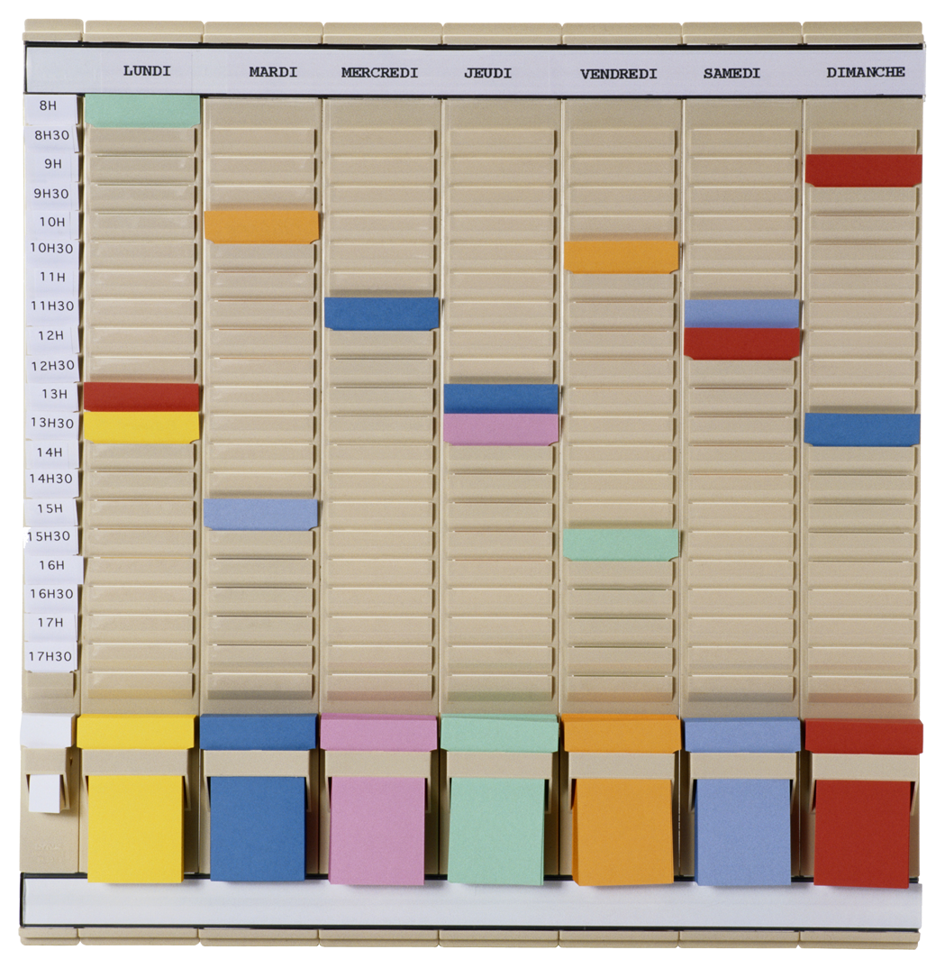
Remember the object and location

Slide 17
+
Come back to the center and wait

Slide 18
Test Session

Slide 20
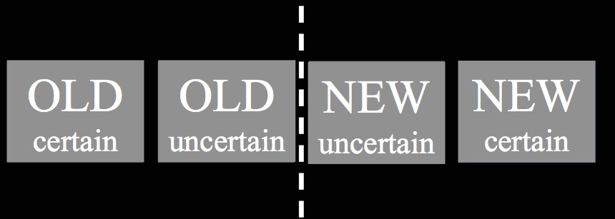
+
+
Choose your answer

Slide 21
+
Choose the location where the object was
Click anywhere outside the boxes if you don’t remember

Slide 22
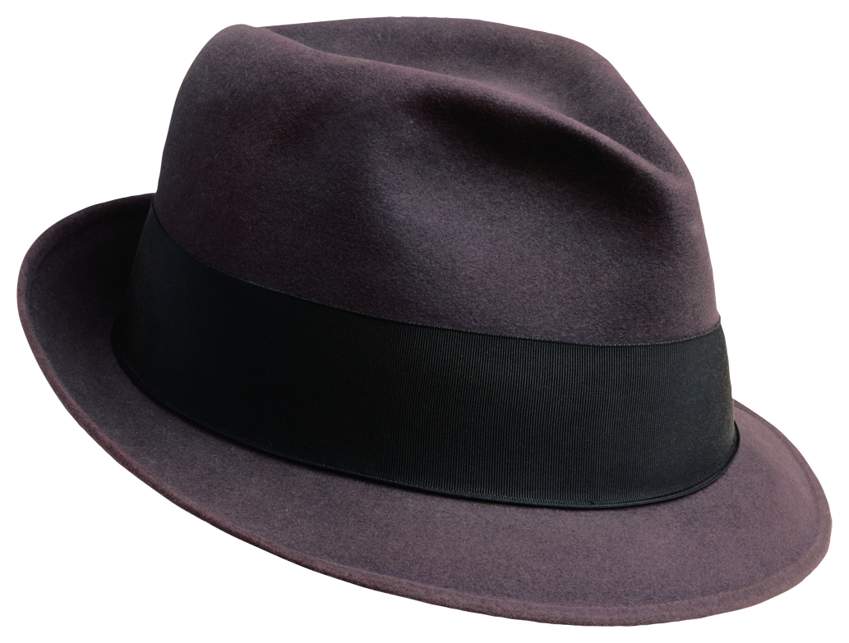

Slide 23
+
+
Choose your answer

